Slide 1
Digital Hormone Model for Robotic Swarms 🤖
Distributed Artificial Intelligence
UNIMORE - 2021/2022
Candeloro Ettore

Slide 2
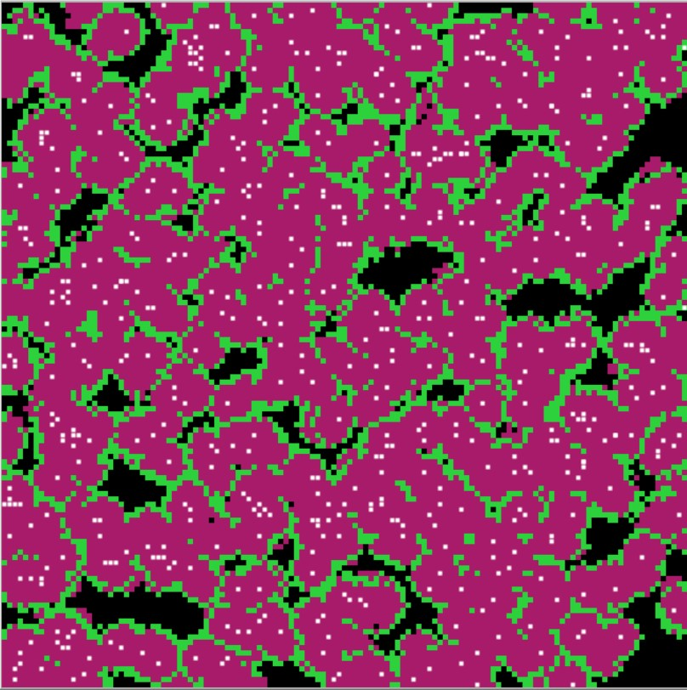
What is this project about?
This work aims to implement the Digital Hormone Model presented in the paper [1] and used to build a swarm of autonomous agents that show capabilities of self-organization and emerging intelligence when interacting with each other in a common environment.
[1] Shen, Wei-min & Will, Peter & Galstyan, Aram & Chuong, Cheng-Ming. (2004). Hormone-Inspired Self-Organization and Distributed Control of Robotic Swarms

Slide 3
How it Works?
The model mimics the behavior of cells in various organism via secreting hormones in the environment and reacting to them.
Each agent in the swarm will do a set of actions in a repetitive loop:
Release hormones in the environment
Select the action to make
Simulate the hormones reaction and dissipation
Repeat to step 1

Slide 4
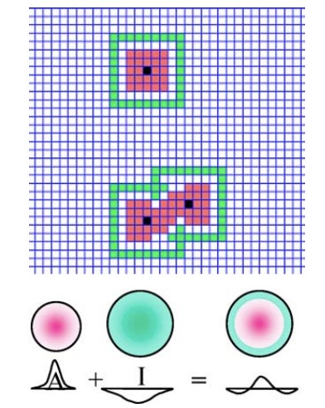
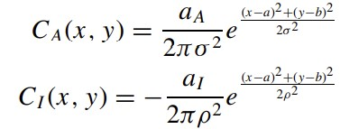
1. Release Hormones
The agents will emit a set of two hormones in a given radius around itself: an activator A and inhibitor I, following the distribution formulas:
We consider the sum of the two hormones for each location and therefore we obtain a sort of “Laplacian" curve

Slide 5
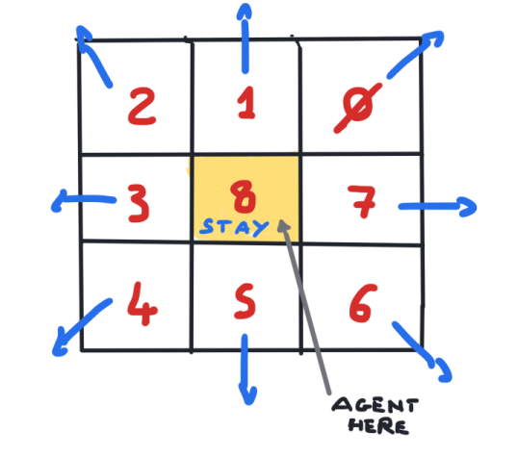
2. Select Action to make
Each agent will measure the cumulative hormones concentration inside the 9 neighbor grids and will select one of the nine grids to move to.
The probability of moving to a given grid is proportional to the concentration of Activator hormones A and inversely proportional to that of the Inhibitor hormone I

Slide 6
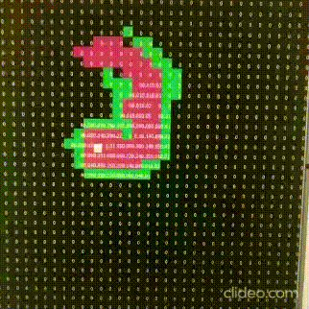
3. Simulate Hormones Reaction and Dissipation
In each patch of the environment, all hormones produced by the agents nearby are summed, and after that a dissipation step take place to ensure the hormone value decreases with time.
The dissipation rate is controllable via a parameter.

Slide 7
Results🔎 Detailed Description + Video Demos -> Git-Hub link

Slide 8
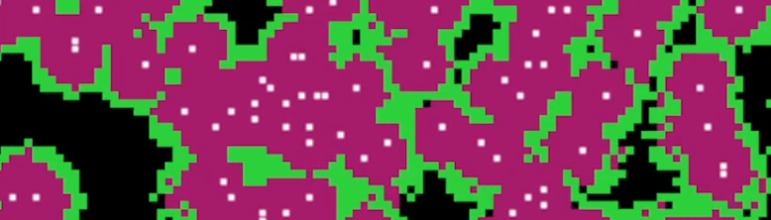
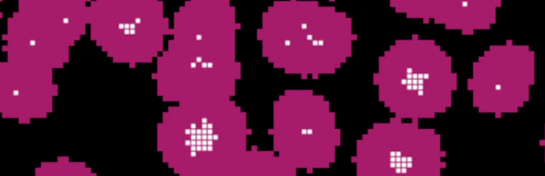
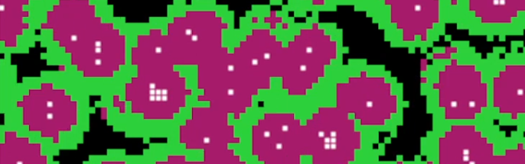
Results (1)
The agents will show a self-organization propension and aggregate/distribute in similar patterns.
The activator hormone will tend to aggregate agents in groups.
The inhibitor hormone will downregulate the aggregation between groups of agents, "repelling" them.

Slide 9
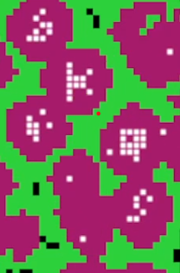
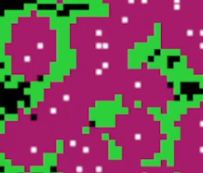
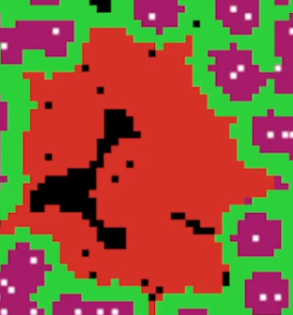
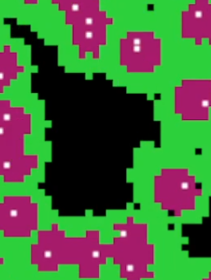
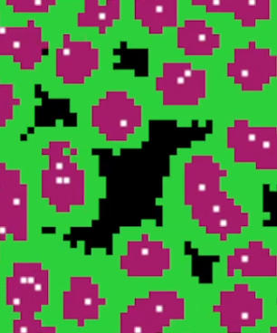
Results (2)
The rate of dissipation will affect greatly the simulation, making aggregation less or more common.
The stochastic behavior will give the swarm of autonomous agents an "edge of chaos" characteristics that improves the system adaptability to stimuli (e.g. explosions/damage).

Slide 10
Example
Link for video example

Slide 11
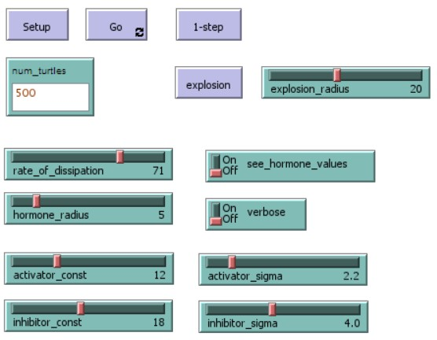
Simulation Parameters
num_turtles
rate_of_dissipation: rate of evaporation for hormones
hormone_radius: hormone max radius
activator_const: amplitude const. for activator
inhibitor_const: amplitude const. for inhibitor
activator_sigma: std deviation const. for activator
inhibitor_sigma: std deviation const. for inhibitor
explosion_radius: max. radius possible for explosions

Slide 12
Changing the simulation parameters
Link for video example

Slide 13
Demostrating Self Organization and Adaptivity… with explosions!💣
Simulating random explosions that will kill the agents in a given radius (from a random patch in the environment) shows interesting results in regards of the self-organization and adaptive capabilities of the swarm.
When an explosions occurs, agents re-organize to fill the new non-occupied spaces, even if the number of turtles is lower than before the damage.
Link for explosion example

Slide 14
Other Possible Uses🔧

Slide 15
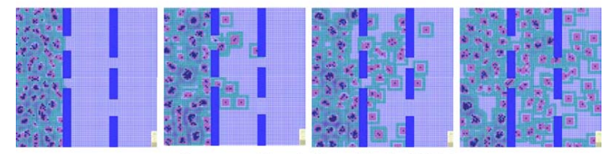
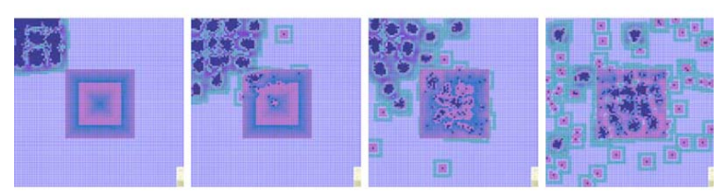
More possible uses
Spread and monitor in buildings
Searching and seizing targets

Slide 16
Thanks for your attention! Questionts?

Slide 17
Backup Slides 💾

Slide 18
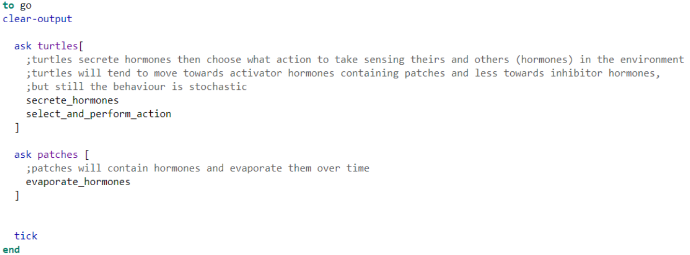
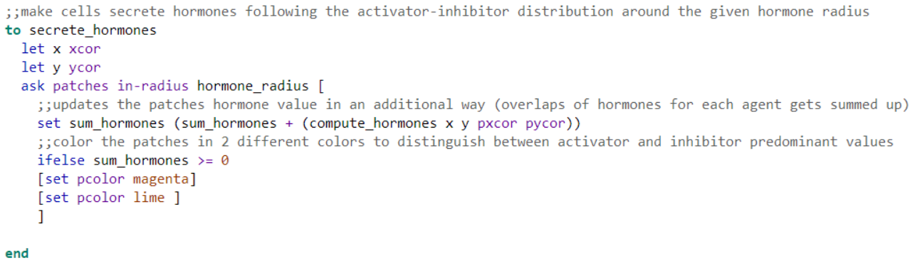
Some Net-Logo code…

Slide 19
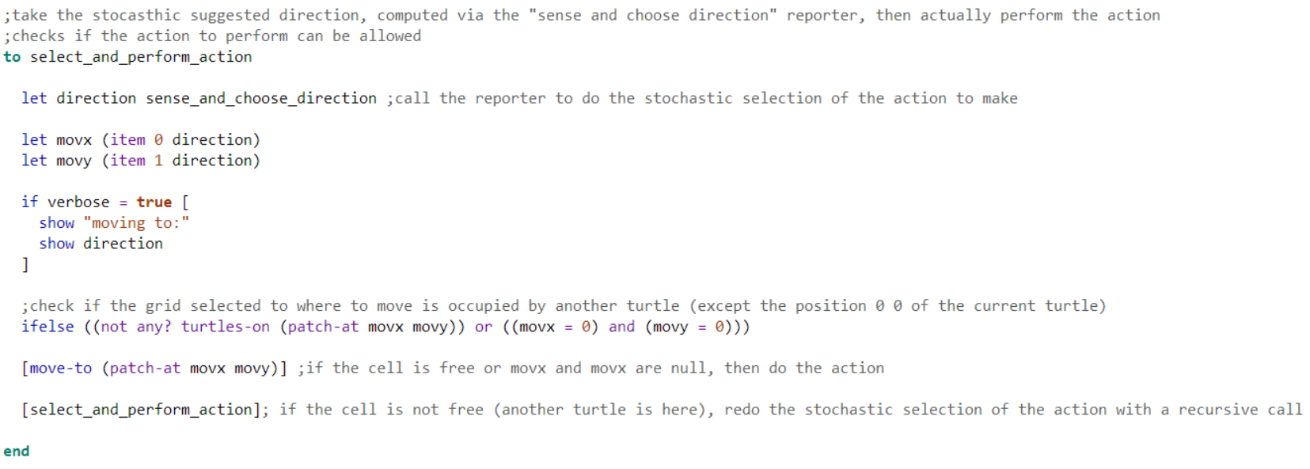
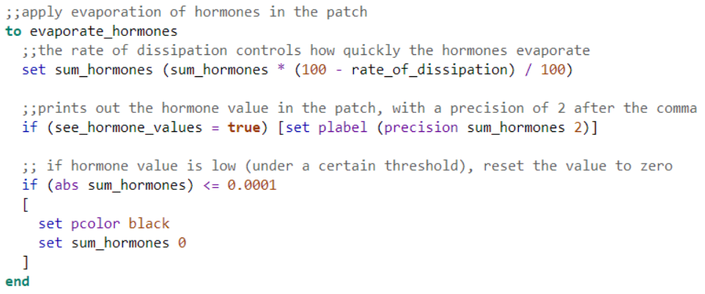
Some Net-Logo code…

